Slide 1



MASTER MECHANICAL ENGINEERING
SPECIALITE ADVANCED MANUFACTURING
Année 2020/2021
Date – 31/08/2021
Thèse de Master MENG-AM
TITRE
QUALITY IN FUSED GRANULAR DEPOSITION FOR DISTRIBUTED RECYCLING.
Les examinateurs Les Superviseurs
Mr. Jean-Francois Petiot. Au LF2L – Mr. Hakim Boudaoud.
Mr. Matthieu Rauch. Mr. Fabio Cruz
1

Slide 2
Table of Content
Host Institute and INEDIT Projects.
Introduction.
Objective.
State of ART.
Methodology.
Results.
Conclusion.
Future scope.
2

Slide 3
Host Institute and INEDIT Project
University of Lorraine was formed on 1st January 2012. The university has a total of 44 laboratories. The ERPI (Research team on innovation processes) is one of university of Lorraine lab. The objective of ERPI is to conduct research in the new innovative processes. The Lorraine Fab Living Lab (LF2L) is a research platform of ERPI with advanced and new innovative machines like Gigabot X XL.
INEDIT Project
INEDIT project has received funding from the European Union’s H2020 research and innovation programme.
INEDIT aims to create an Open Innovation European DIT ecosystem for sustainable furniture co-creation using 3D printing technology.
3

Slide 4
Introduction
Traditional manufacturing process like machining make use of subtraction of material which results into a lot of residual material and waster.
A new kind of manufacturing process called additive manufacturing process makes a product by layer-by-layer addition Which reduces the residual material.
Fused deposition modeling uses filament to 3D print.
Limited type of polymeric filaments are available in the market.
Fused granular fabrication is a polymeric additive manufacturing process which make use of pellets rather than traditional filaments as feedstock material making 3D printing with different material including recycled material quite comfortable.
pellet based AM has a compression screw inside a barrel and the barrel is surrounded by one or more heating blocks. Heating blocks provide sufficient heat energy to change the pellets from solid stated to liquid state and the compression screw helps in providing enough pressure to push the liquefied thermoplastic.
4

Slide 5
Objective
The main goal of the internship is to evaluate the printing quality and reproducibility of a Fused Granular Fabrication machine
The main specific goals of this internship are:
Realization of first test using virgin material (PLA) for printability purposes and calibration tests with regarding to the commercial machines.
Evaluate the limit conditions of the open hardware machine using Design of Experiments (DoE) approach.
Fabrication of printing samples to evaluate the quality.
5

Slide 6
State of art
Literature review
Following the literate review protocols 33 articles were read,Out of 33 articles, 10 articles were related to print quality.
Sr.No. | Refrences | Benchmarking model | Print quality | Process Parameters
1 | Kumar, N et al. | solid test specimen | shape degradation, bonding, warpage | barrel temperature and bed temperature
2 | Minetola, P et al. | hollow square vase | overfill | print speed, extrusion multiplier and infill %
3 | Woern, A. L. et al. | line and single walled hollow cylinder | width, height, and weight (quantitative measurements). | print speed, extrusion multiplier and heating block temperature
4 | Jain, P. K et al. | line and vertical stacked lines | overfill and bonding | bed temp, barrel temp, deposition speed, screw speed and distance between nozzle and bed
5 | Hentschel, L et al. | solid cube | overfill, dimension (quantitative measurements), warpage, color evenness | discharge rate, nozzle temperature, overlap, chamber temperature
6 | Büyük, A. M et al. | hollow cuboid | elephant foot, bonding, overfill | print speed and layer height
7 | Pappas, J. M et al. | solid test specimen | bonding, fiber exposure | material deposition rate, print speed and nozzle title angle
8 | Mohan Pandey et al. | line | Dimensions (quantitative measurements) | screw speed and barrel temperature
9 | Kumar, N et al. | solid test specimen | overfill, color, dimension (quantitative measurements) | layer thickness, nozzle temp, drop overlap, form factor, chamber temp
10 | Trejo, E. M et al. | vertical stacked lines |  | barrel temperature and bed temperature
6

Slide 7
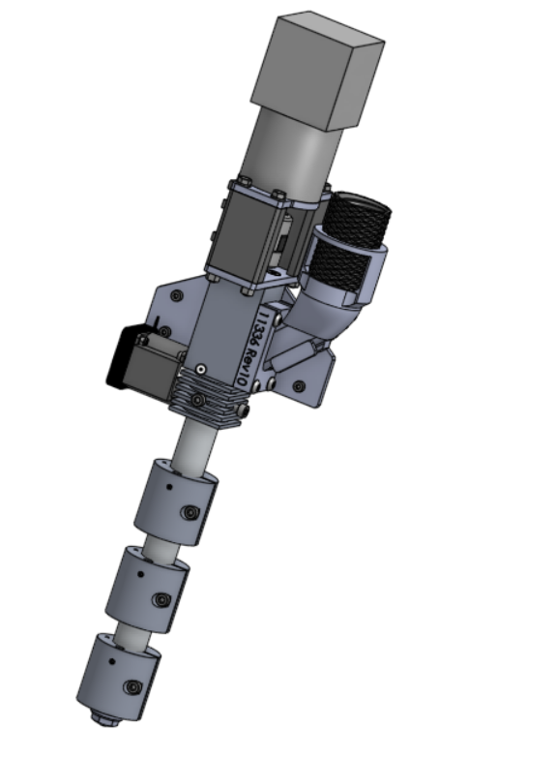
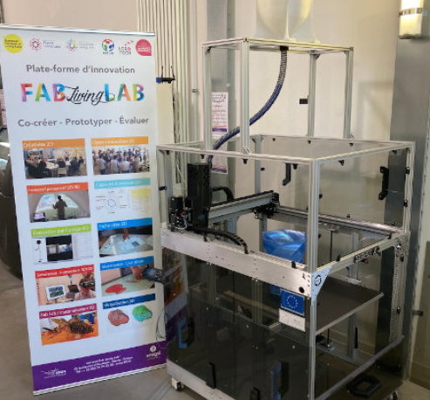
Methodology
Machine
Stepper Motor
Feedthroat
Thermal dissipator
Barrel
Heating block (T3,T2,T1)
Gigabot X XL
Nozzle (1,75mm)
Extruder system
7

Slide 8
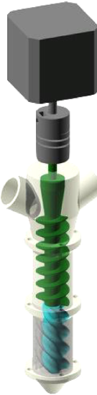
Methodology
Machine
Stepper Motor
Feedthroat
Thermal dissipator
Barrel
Heating block (T3,T2,T1)
Nozzle (1,75mm)
Extruder system
7

Slide 9
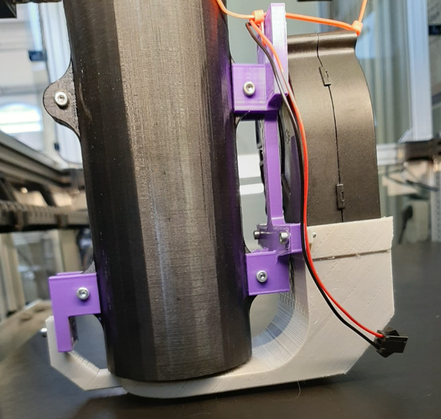
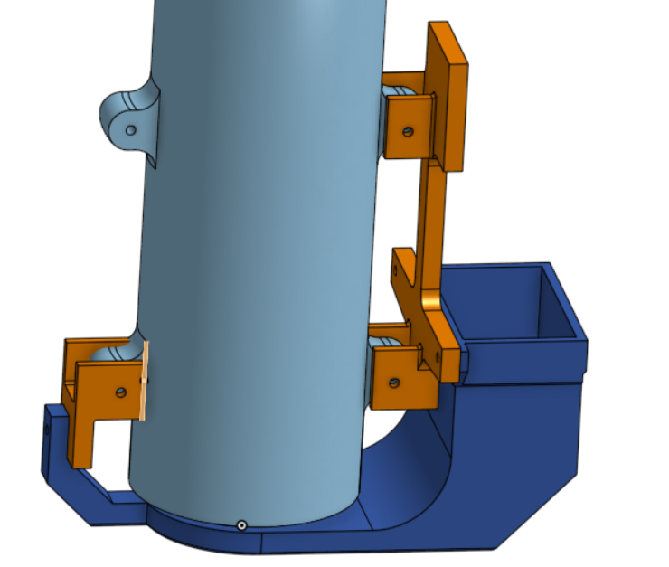
Methodology
Machine
CAD of cooling system on Onshape
3D printed Cooling system by FDM using DfAM principles
8

Slide 10
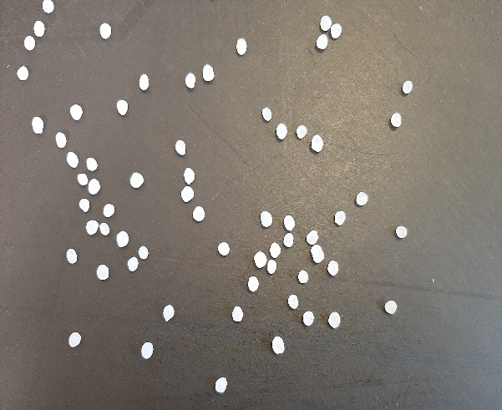
Methodology
Material
Virgin PLA pellets from Natureplast as feedstock material for 3D printing was used.
The thermoplastic PLA has a Melt Flow Index [MFI] of 3 g/10min.
9

Slide 11
Methodology
Process Parameters
Process Parameters
Print speed
Extrusion multiplier
Layer height
T1 heating block temperature
Cooling system
10

Slide 12
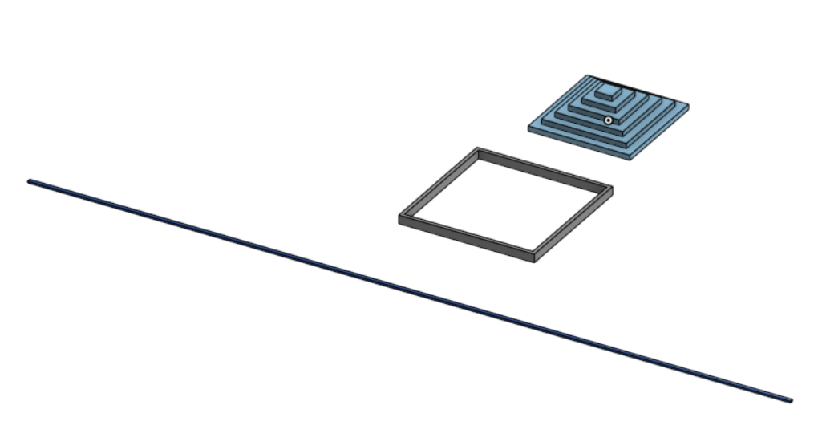
Methodology
Design of Experiments Benchmarking model
Sr Nos. | DoE model | Dimensions
 |  | Width/length (mm) | Height(mm)
1 | Level 1 (line) | 2.1 mm | 1 mm
2 | Level 2 (Square Vase) | 80 mm | 5 mm
3 | Level 3 (Square step pyramid)
 | Step 1 | 60 mm | 5 mm
 | Step 2 | 50 mm | 5 mm
 | Step 3 | 40 mm | 5 mm
 | Step 4 | 30 mm | 5 mm
 | Step 5 | 20 mm | 5 mm
 | Step 6 | 10 mm | 5 mm
CAD of benchmarking models
Dimensions of benchmarking models
11

Slide 13
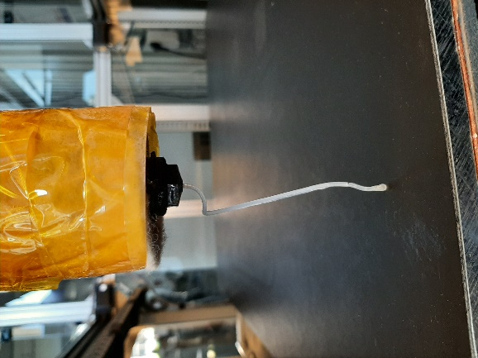
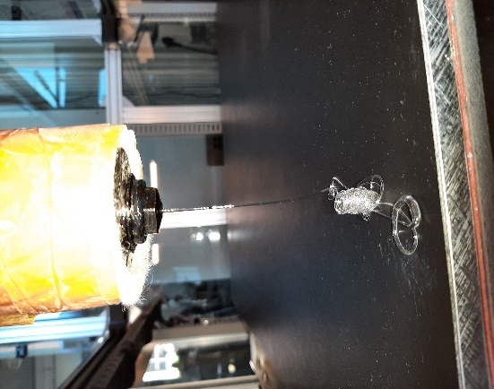
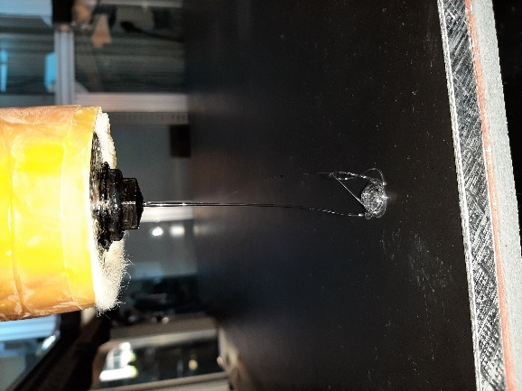
Results
Limits of Process Parameters
T1 heating block Temperature
a : 185°C
b : 190°C
c : 200°C
Brittle and white in color
ductile and tranparent
ductile and tranparent
Visual inspection of flow from nozzle for various temperature
12

Slide 14
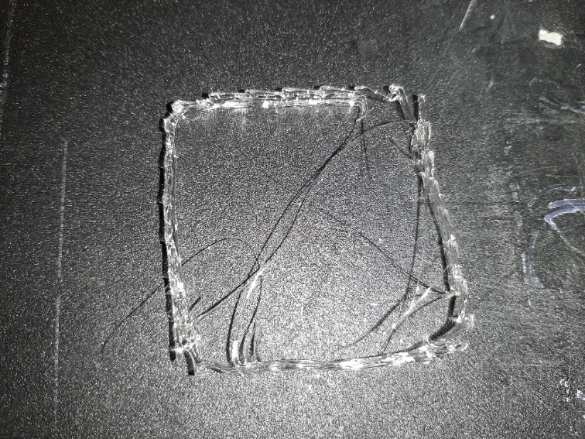
Results
Limits of Process Parameters
Extrusion multiplier
Square vase with extrusion multiplier as 0,6 (insufficient and discontinuous flow)
Sr No | Layer height | Print speed | T1 heating block temperature | Cooling system
1 | 0.5mm | 800 mm/min | 190°C | ON
13

Slide 15
Results
Limits of Process Parameters
Process parameters lower and higher limits for DoE
Process parameters | Layer height (mm) | Print speed (mm/min° | Extrusion multiplier | T1 heating block temperature (°C) | Cooling system
Lower limit (-1) | 0.5 | 800 | 0.7 | 190 | OFF
Higher limit (+1) | 1.00 | 1600 | 1.0 | 200 | ON
14

Slide 16
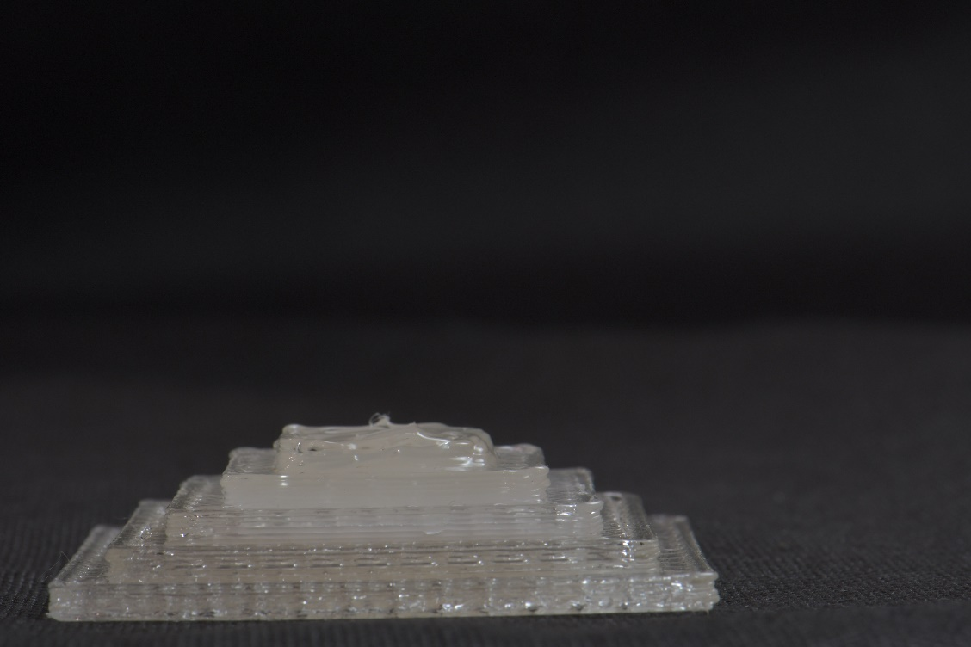
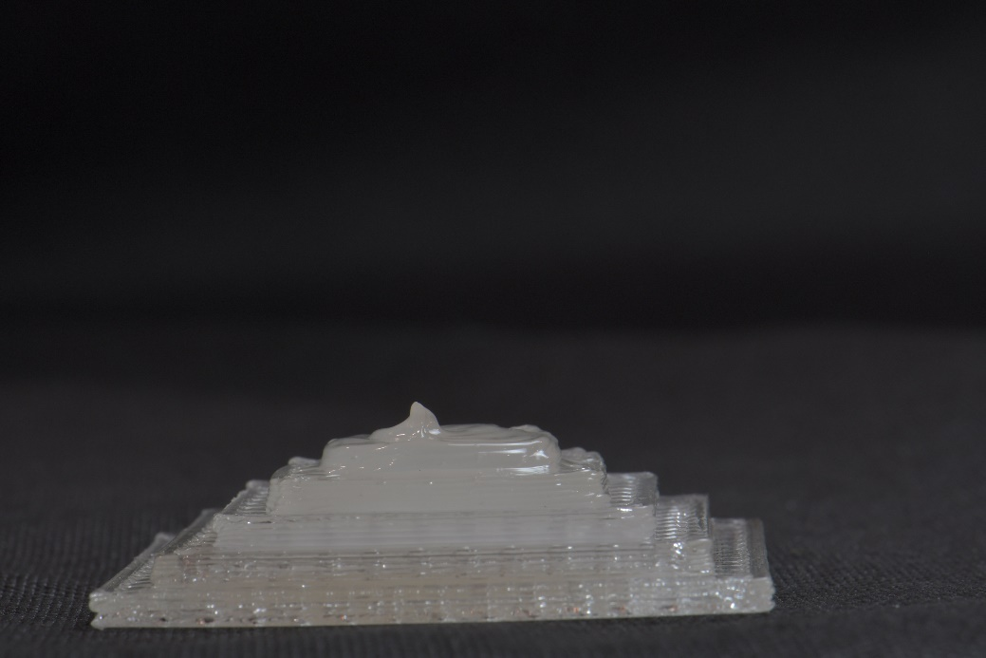
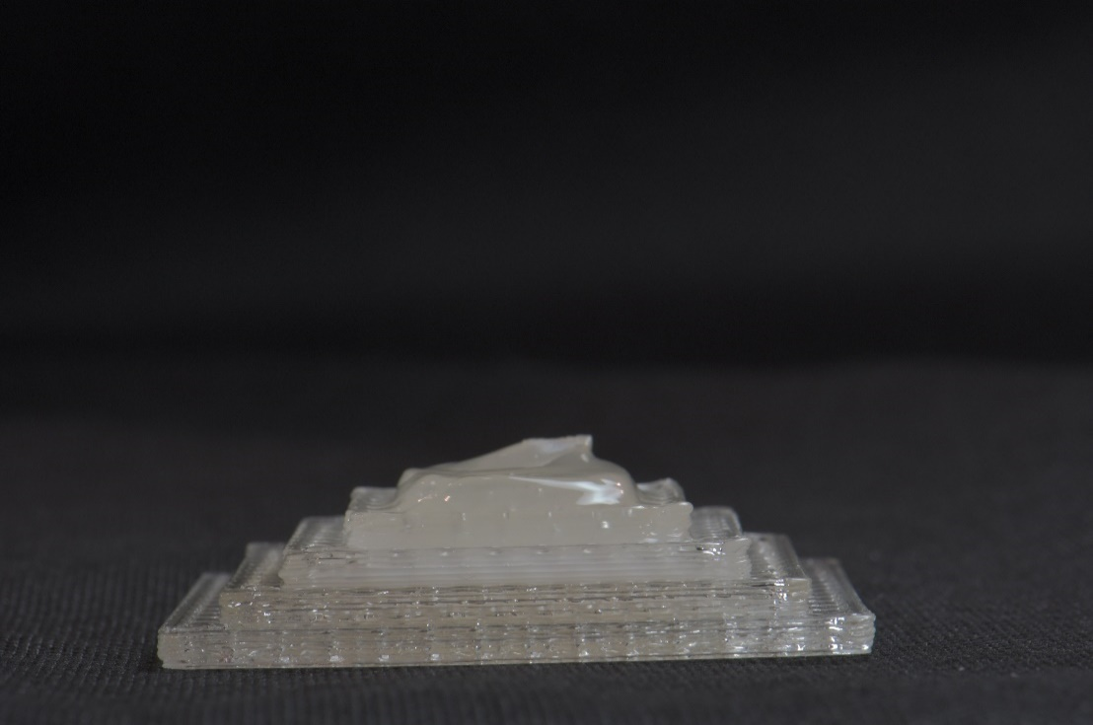
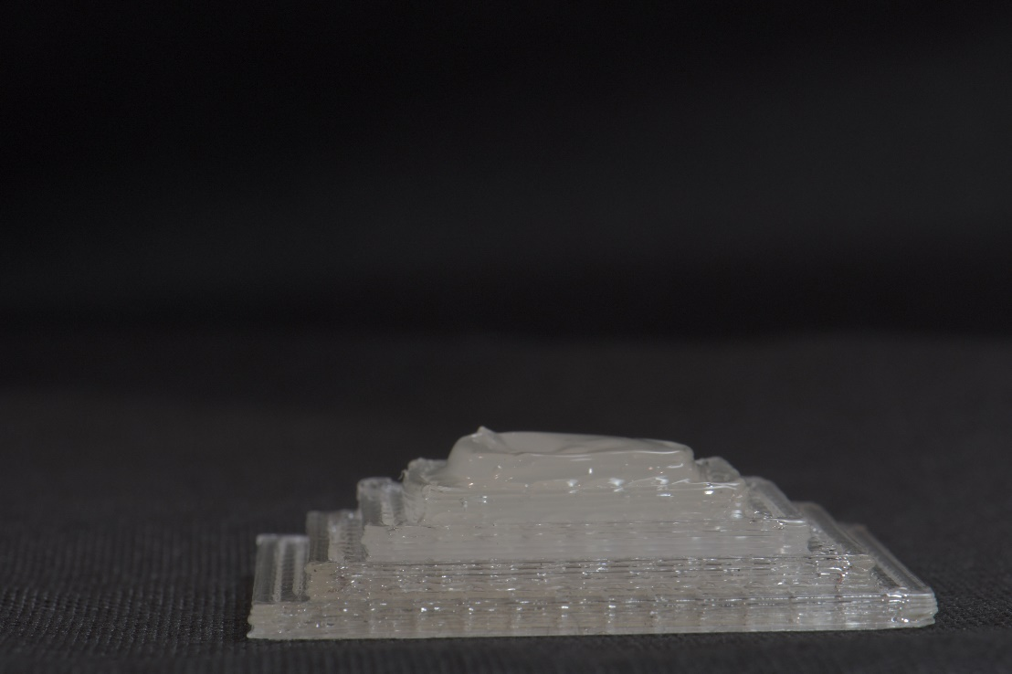
Results
DoE resuts
Visual Inspection
Print quality – colour unevenness.
Process parameter affecting it – print speed and T1 heating block temperature
T1 heating block temperature and print speed at higher limit results in early colour uneveness.
DoE 1
DoE 2
DoE 5
DoE 6
Sr No. | DOE
 | print speed | extrusion | temperature | layer height | Cooling system
1 | -1 | -1 | -1 | -1 | -1
2 | 1 | -1 | -1 | -1 | -1
5 | -1 | -1 | 1 | -1 | -1
6 | 1 | -1 | 1 | -1 | -1
15

Slide 17
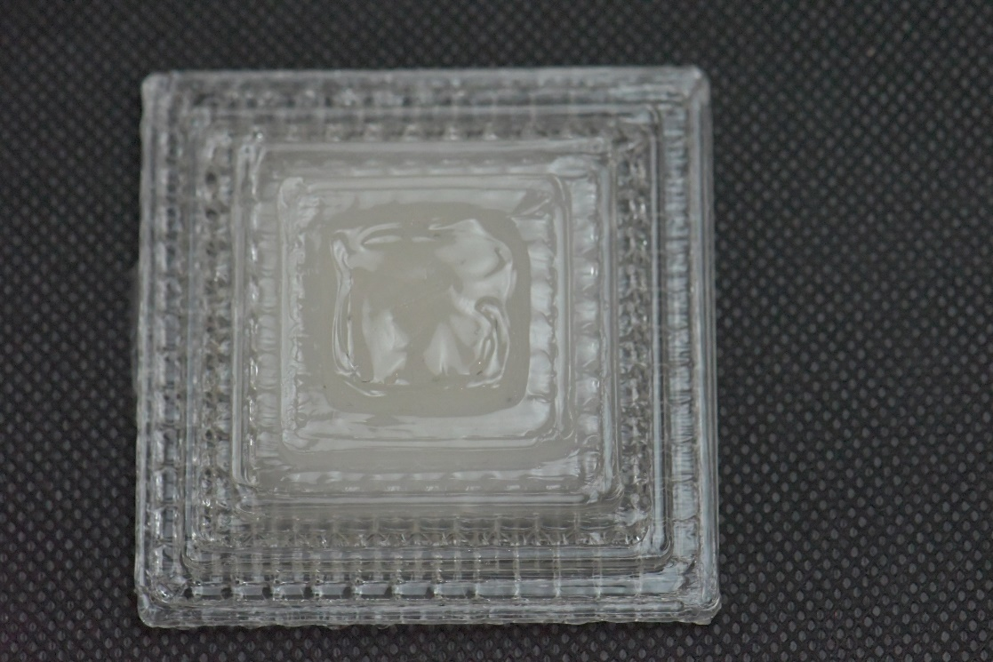
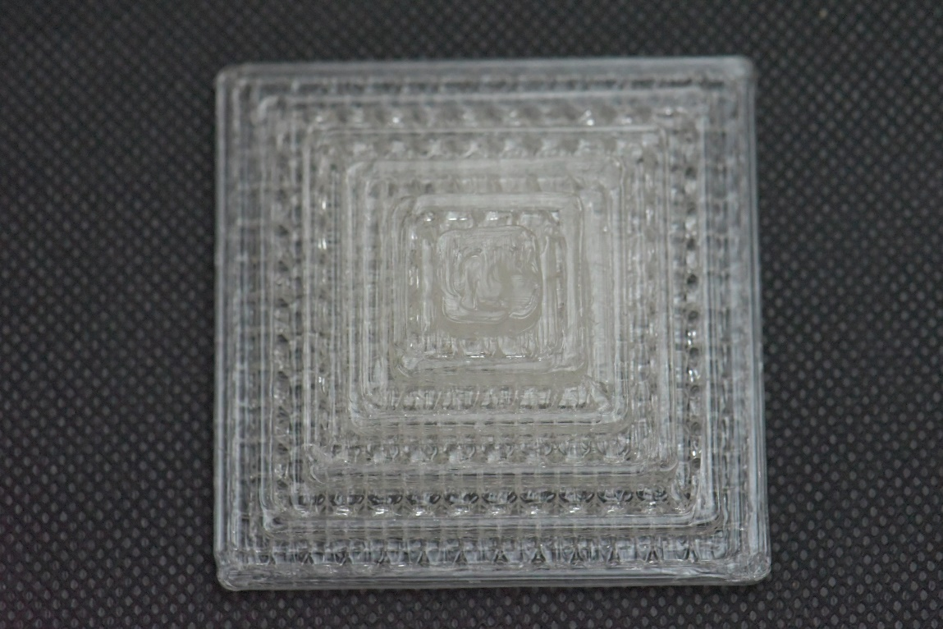

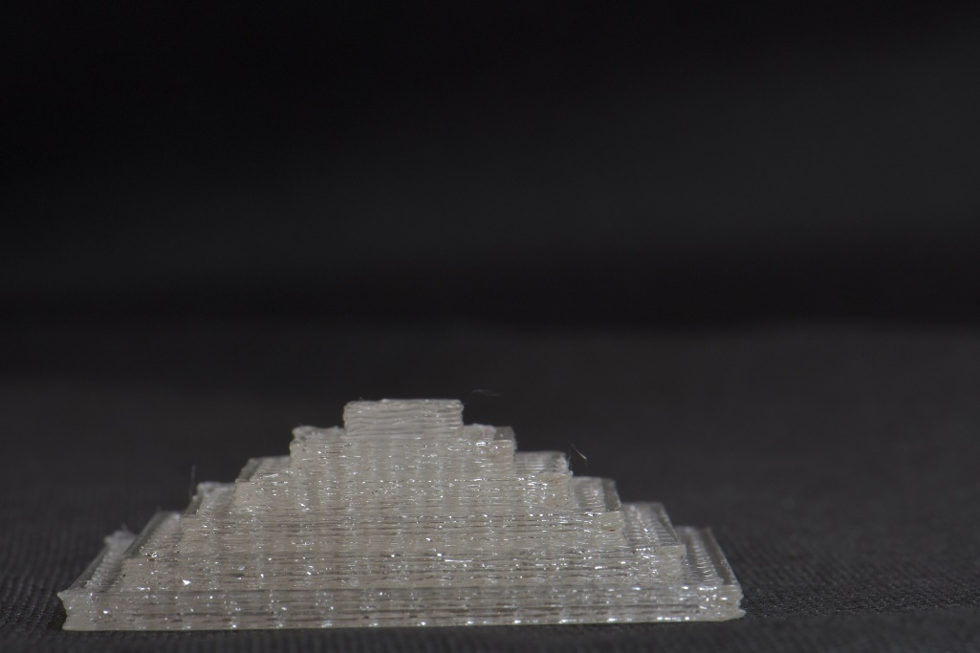
Results
DoE resuts
Visual Inspection
Top View
Print quality – shape deformation and colour unevenness.
Process parameter affecting it –
Cooling system.
Good structural integrity and color evenness at active cooling system
DoE 1
DoE 17
Front View
16

Slide 18
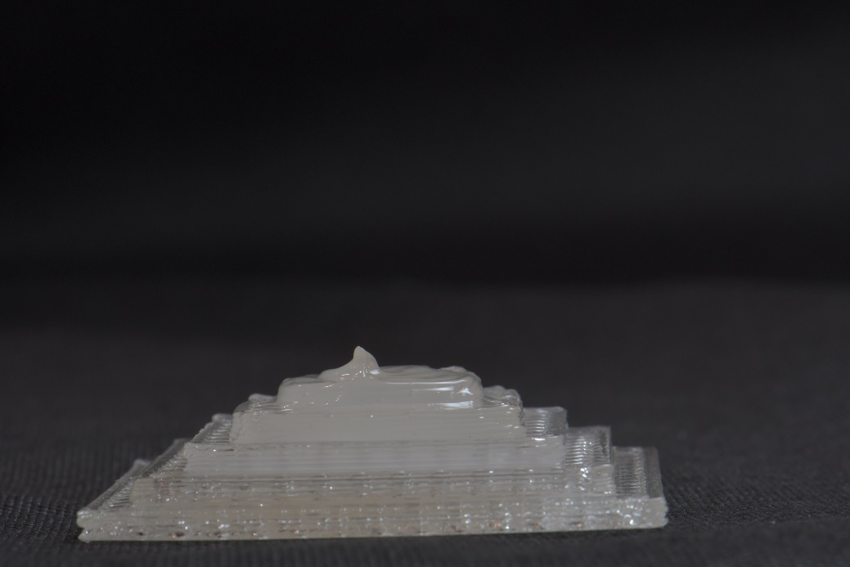
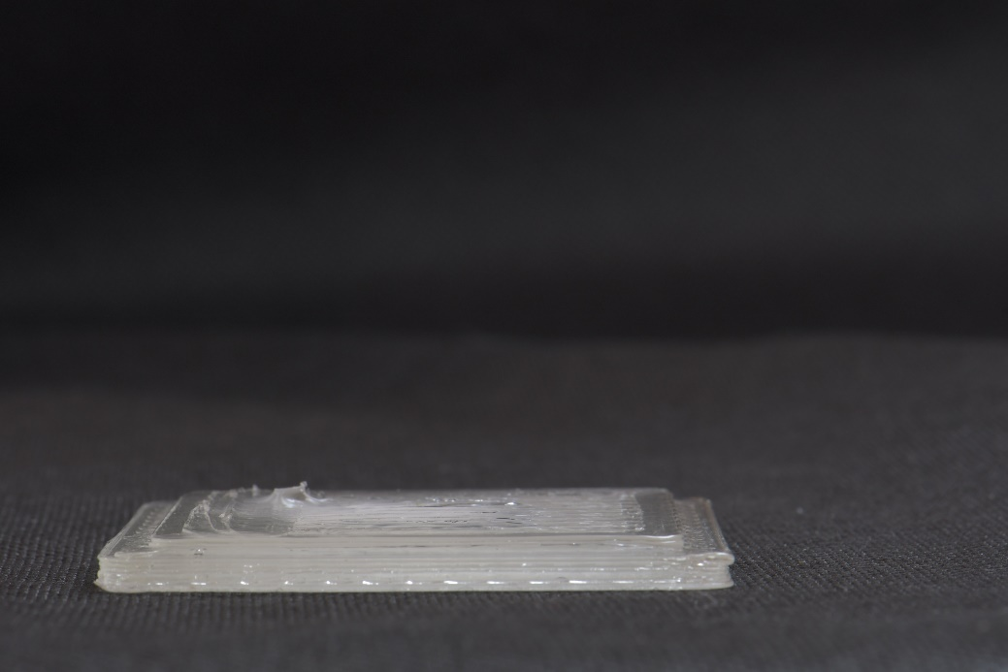
Results
DoE resuts
Visual Inspection
DoE 2
DoE 3
Print quality – Overfill
Process parameter affecting it – Exrusion multiplier
Extrusion multiplier at higher limit leads to overfill
Sr No. | DOE
 | print speed | extrusion | temperature | layer height | Cooling system
2 | 1 | -1 | -1 | -1 | -1
3 | -1 | 1 | -1 | -1 | -1
17

Slide 19
Results
DoE resuts
Part quality
Main effect of print speed
Irrespective of Levels the variation in width/length and weight increased as the print speed increase from 800mm/min to 1600mm/sec.
As print speed increases the level 1 and Level 3 shows increase in hight variation however level 2 gradually decreases.
For both level’s the variation in weight increased when print speed increased from 800mm/min to 1600mm/min.
18

Slide 20
Results
DoE resuts
Part quality
Main effect of extrusion multiplier
Irrespective of Levels the variation in width/length, weight and height increased as the extrusion multiplier increased from 0,7 to 1.
19

Slide 21
Result
DoE resuts
Part quality
Main effect of layer height
For variation in width/length, Level 1 shows an increased slope while level 2 remains steady however level 3 decrease gradually when layer height changes from 0,5mm to 1,00 mm.
Height variation increases for level 1 while level 3 also increased but less steeply however level 2 decreases when moving from lower limit to hight limit of layer height.
Level 1 decreases and level 2 increases for variation in weight for layer height.
20

Slide 22
Results
DoE resuts
Part quality
Main effect of cooling system
Variation in width/length decreased for level 1 when active cooling than inactive cooling system, however the variation increased for level 2 and Level 3.
Level 1 and Level 3 showed decrease in height variation but level 2 showed increases in variation for change in limit of cooling system.
Irrespective of the level the weight variation decreased when moving from inactive cooling to active cooling.
21

Slide 23
Results
DoE resuts
Part quality
Main effect of Temperature
When T1 heating block temperature changed from 190°C to 200°C the width/length variation increased for all the levels however sharply for level 3.
For variation in height, Level 1 showed no change but level 2 showed a gradual decrease however level 3 showed an increase in slope.
Level 1 variation in weight decreased as the temperature change from 190°C to 200°C while level 2 variation increased.
22

Slide 24
Results
DoE resuts
Part quality
Interaction between process parameters
Interaction between print speed and extrusion multiplier for variation in width/length
Interaction in all levels
Interaction between print speed and extrusion multiplier for variation in height
No interaction in level 1.
Interaction in Level 2 and Level3
23

Slide 25
Results
DoE resuts
Part quality
Interaction between process parameters
Interaction between layer height and extrusion multiplier for variation in width/length
No interaction in level 1.
Interaction in Level 2 and strong in Level 3
Interaction between layer height and extrusion multiplier for variation in height
No interaction in level 1.
Interaction in Level 2 and Level3
24

Slide 26
Conclusion
Print quality by visual inspection is only visible in Level 3 which makes its very important.
For T1 heating block temperature at 190°C and print speed 800 mm/min the color unevenness starts from step 4 of level 3 however at 200°C and print speed 1600 mm/min it starts from step 3.
Cooling system is important to maintain structural intregity and color evenness (transperent in this case), moreover to 3D print smaller object.
Extrusion multplier is responsible for overfill if the value is too high.
Main effect of process parameters are different for different levels.
Level 3 showed the highest variation in width/length, height amongs all levels.
Process parameter optimisation with benchmarking model of level 1 will not lead to good print for complex models such as level 3. therefore benchmarking model is very important for process parameters optimisation.
Interaction between process parameters is also present which has influence on part quality.
25

Slide 27
Future scope
Interaction between process parameters is observed which has influence on part quality.
Conducting more Design of experiements to validate the design of experiments.
Differentiate between the significant and insignificant interaction by ANOVA Table.
Formulating the DoE model equations for variation in height, width/length for each level (level 1, level 2 and level 3);
Optimisation of the process parameters for variation in hight, width/layer for each level and to check if they thends to same or different optmised process parameters values.
26

Slide 28
Thank you
27

